Slide 1
The Power of Information
July 7, 2017
OTCQB: GBSN

Slide 2
Regarding forward-looking statements
All statements in this presentation that are not statements of historical fact are forward-looking statements, including statements about any of the following: any projections of earnings, revenue, sales, profit margins, cash, working capital, or any other financial terms; the plans, strategies and objectives of management for future operations or prospects for achieving such plans; statements regarding new, existing or improved products, including but not limited to, expectations for sales and marketing, expectations for success of new, existing or improved products or government approval of new or improved products; future economic conditions or size of market opportunities; expected costs; statements of belief, including as to achieving 2017 and 2018 plans; expected regulatory activities and approvals, product launches, and any statements of assumptions underlying any of the foregoing.
Forward-looking statements are based on expectations and assumptions as of the date of this presentation and are subject to numerous risks and uncertainties, which could cause actual results to differ materially from those described in the forward-looking statements. These risks and uncertainties include the following: our limited capital resources and limited access to financing; the discretion of regulatory agencies to approve or reject new, existing or improved products or to require additional actions before approval or to take enforcement action; research and developments efforts will not be successful or may be delayed in delivering products for launch; the purchasing patterns of our customers; and the willingness of hospitals and laboratories to adopt a new or improved product.
Important additional factors that could cause actual results to differ materially from those indicated by such forward-looking statements are set forth in the Company’s Annual Report on Form 10-K for the year ended December 31, 2016 and in the Company’s Quarterly Report on Form 10-Q for the quarter ended March 31, 2017, under the caption “Risk Factors,” both of which are on file with the Securities and Exchange Commission and available on the Company’s website, www.gbscience.com/investors. We disclaim any intention or obligation to update or revise any financial projections or forward-looking statements due to new information or events.

Slide 3
The Company
Low-Cost, Versatile Solution for Infectious Disease MDx Market
We are the only provider of low- and mid-plex systems in the molecular diagnostics market for infectious disease
Low-cost, ASP-focused model improves the reimbursement result for customers, making our system more attractive than those of many of our competitors
We focused on product menu and customer acquisition in 2015-2016
Menu of FDA-cleared assays grew from 2 to 6
Over 400 systems were placed, with 230+ customers using our solution
We are focused on accelerating revenue growth in 2017-2018
New business pipeline exceeds $5.0 million, with an 82% historic win rate
We are introducing high-value panels that have greater gross margins
We have restructured our capitalization and eliminated variable price instruments

Slide 4
Expanded Menu Driving Pipeline of New Business
$5,032,206
$2,265,588
$658,992

Slide 5
Expected Average Customer Size has Increased
Rapidly Growing New Customer Annual Revenue Projections

Slide 6
Our Markets
MDx Testing Improves Patient Outcomes & Lowers Cost of Care
Example: Blood Sepsis
Problem
Leading cause of morbidity & mortality
Culture takes ~ 3 days for a result
Increased cost, delayed treatment, higher patient risk
Solution
MDx reduces Time to Result to 1 day
Length of stay reduced by 6.2 days
Average savings is ~ $7,000 per incident

Slide 7
Our Markets
Our Tests Target an Estimated $1.75B Addressable U.S. Market
Gastro Intestinal Distress $800MM*
Blood Sepsis $200MM
Whooping Cough $250MM
Group B Strep (Neo-natal Meningitis) $200MM
Products in Development Pipeline $300MM+
* Company estimates

Slide 8
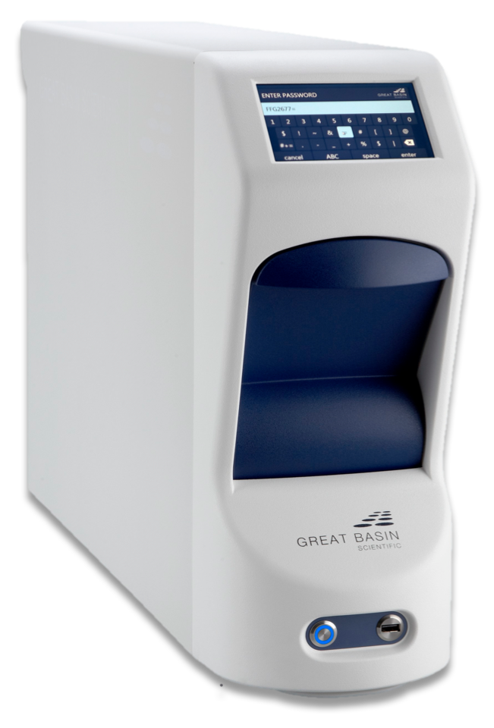
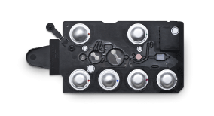
Our System
Great Basin’s Affordable Solution Designed for Small-Medium Hospitals
Analyzer
Works with all Great Basin assays
Does not require special staffing to read results
Small footprint – requires little bench space
No CapEx, value proposition
Cartridges
Single-use, minimal steps to prep
Up to 5 answers per specimen
Same cartridge design for all assays
Designed for cost and manufacturability

Slide 9
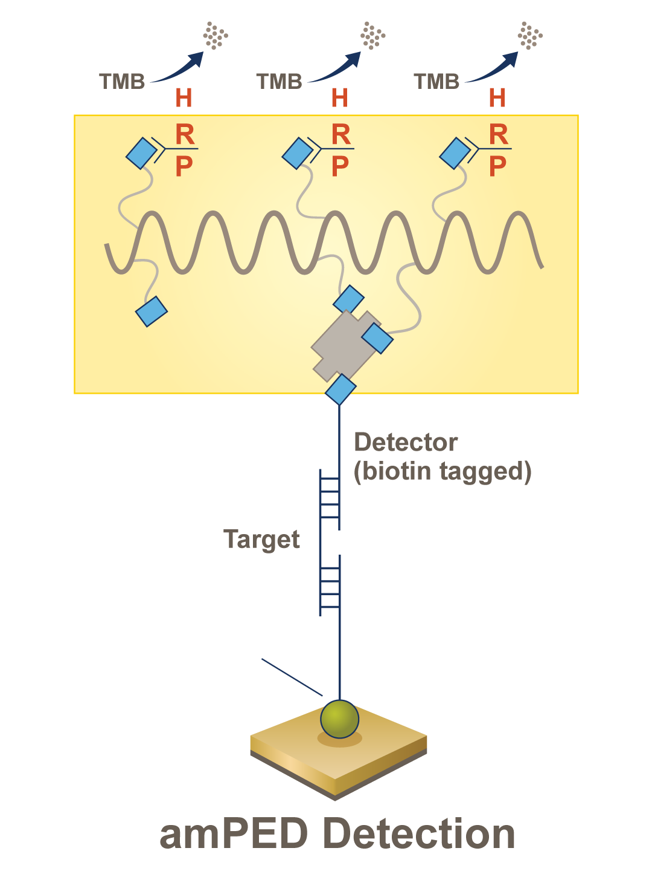
Our Technology
Highly Sensitive Multi-Plex Detection
First U.S. Patent issued 2013
$0.23 per chip
Up to 64 target array
Sensitivity for direct-from-specimen detection

Slide 10
Our Product Offering
Great Basin Product Menu
Commercially Available Products | Launch Date
Toxigenic C. difficile Test | November 2012
Group B Streptococcus Test | May 2015
Shiga Toxin Direct Test | September 2016
Staph ID/R Blood Culture Panel | October 2016
Bordetella Direct Test | April 2017
Awaiting FDA Clearance
Stool Bacterial Pathogens Panel | Feb 2017 (Investigation Use Only)
In Development | Expected Clinical Trial Start
CT/NG/TV Test | 2018
Stool Parasite Pathogens Panel | 2018
Candida Blood Infections Panel | 2018
SA Nasal Screen Test | TBD

Slide 11
The Competition
Only Great Basin Offers a Single Capital Solution vs. Requiring Two Capital Expenditures from Two Vendors
1-2 pathogen tests that answer: “Is it X?”
Lower Reimbursement Lower Cost
C. diff MRSA Sexually transmitted disease
5-25 pathogen panels that answer: “What is causing it?”
Higher Reimbursement Higher Cost
Diarrhea Blood sepsis Respiratory

Slide 12
Market Dynamics
The Competitive Advantages of Mid-Plex over Mega Panels
Mid-Plex
3-6 pathogens
Reasonable cost
Single syndrome per panel (leverages empirical diagnosis)
Cover 90%-95% of likely cause of disease
Answers drive therapy
Mega Panels
10-25 pathogens in a single assay
High cost
Multi-syndromic (include more than one disease state)
Contain obscure, rarely seen pathogens
Not therapy oriented

Slide 13
The Mid-Plex to Mega Panel Difference
Stool Bacterial Pathogens Panel Competitive Analysis
Comparative features
Targets | 5 (Bacterial) | 22 (Bacterial, Viral, Protozoa)
Panel pricing | $60 - $75 | $120 - $130
Reimbursement | ~$134 to $290 | ~$134 to $290*
2015 Payor rejection rate | 6.5% | 19.5 %+ **
Mega Panels
*Mega-panel providers suggest their customers use CPT codes that allow for higher reimbursement rates. However, Great Basin’s surveys of hospitals indicate a lack of success with that tactic, as well as a growing challenge by hospitals to get reimbursement adequate to cover the fully-burdened costs associated with running mega panels.
**Source: CodeMap and CMS

Slide 14
Market Dynamics
Growing Clinical and Payor Resistance to Larger Panels:
Palmetto Local Coverage Determination Draft
Panel must be “reasonable and necessary”
Targets must represent a common syndrome (i.e. truly syndromic)
There must be broad applicability (pathogens found in only select populations not appropriate)
Must aid physician in directing therapy; not just identify what pathogen is present
Reimbursement not appropriate for epidemiological studies
Reimbursement not appropriate for confirmatory testing or screening
“[For] most patients, negative test results for common pathogens should precede testing for uncommon pathogens in the interest of controlling the cost of testing for both the patient and the institution.”
-Dr. Alexander McAdam, MD, PhD, Harvard Med School and Boston Children’s Hospital JCM, 2015 53:10
“A panel that includes pathogens that are very rare, or a panel in which all pathogens do not cause overlapping clinical syndromes, or when some pathogens are found only in specific patient populations (immunocompromised patients) is not reasonable and necessary.”
-Palmetto GBA (Medicare contractor), Local Coverage Determinations (LCDs), June 14, 2017, www.cms.org

Slide 15
The Great Basin Mid-Plex Advantage
Great Basin Mid-Plex Meets Palmetto and Clinical Preference
Contains only targets likely after physician provides empirical diagnosis
Targets represent a single syndromic group
No confusing, statistically unlikely or unnecessary information
Answers limited to those that guide patient therapy
Reimbursement above cost of test
Lower rate of payment denial post-testing

Slide 16
The Winning Solution
Great Basin’s Low/Mid-Plex Advantage
 | Yes | No | Yes | Yes | Yes | No
 | Low-Plex Mid-Plex | Low-Plex | Low-Plex | Mega-Plex | Mega-Plex | Low-Plex Multi-Plex
 | No | No | Yes | Yes | Yes | Yes
Sample to
Result
Menu
CapEx
Required

Slide 17
The Solution
What our customers are saying
A panel like this is what we need for a limited micro staff in terms of numbers and experience reading culture plates. [SBPP] will primarily do away with our stool bench.
- Micro Biology Supervisor
We actually had 2 patients this past week which were Negative by the Meridian kit. One was a child and the other an adult. We ran your assay [STEC] and got Positive results for both. How timely. Glad we switched.
-Microbiology Supervisor
My techs were unanimous the Great Basin assays were easier to use than our current platform for CDIFF, GBS and MRSA.
- Microbiology Supervisor
I love this system. So easy to run and easy to adopt since we don’t have capital equipment to purchase. We’ll use every test you have.
- Lab Director

Slide 18
Commercially-Focused Management Team
A Track Record of Success
Ryan Ashton
President, CEO & Director
Operational, transactional & commercialization expertise
Prior: CEO of Printelligent; VP Sales/Marketing of Inari; Sr. VP Sales/Marketing of Megahertz
Rob Jenison
CTO & SVP of R&D
Creator of molecular diagnostic testing platforms, expertise in clinical microbiology
Prior: Assoc. Dir/R&D – Inverness Medical/Biostar; Sr. Researcher & Scientist – NexStar & Isis Pharmaceuticals
Jeff Rona
CFO
Financial, transactional & business development expertise
Prior: CBO – GlobeImmune; CFO – AlgoRx Pharmaceuticals; Dir/Finance – Antigenics; IB – UBS Warburg
Sandra Nielsen
SVP Sales, Marketing & HR
Product portfolio, commercialization, sales strategy, branding & communications expertise
Prior: Sr. Marketing positions at Pearson, Omniture, iBAHN, Inari, Viewpoint

Slide 19
Board of Directors
Diversified and Experienced
David Spafford
Executive Chairman
Founding investor of GBSN; Chairman since inception
Founder track record, operations and transaction expertise
Co-founder of Megahertz, sold to US Robotics for $450M; angel investor & philanthropist.
Ron Labrum
Director
GBSN director since 2014
Private equity partner at Linden Capital Partners – investing in healthcare & life sciences
Past CEO of several HC companies; current director of Wright Medical Group (Nasdaq: WMGI)
Sam Chawla
Director
GBSN director since 2014
Portfolio manager Perceptive Advisors – healthcare-focused investment fund
UBS Securities & Credit Suisse IB experience; current director of VBI Vaccines (Nasdaq: VBVI)
Kirk Calhoun
Director
GBSN director since 2015
Audit and accounting expertise; deep knowledge and experience in pharmaceutical industry
Current director of Ryerson Holding Corp (NYSE:RYI) & NanHealth (OTC: NH) + 3 private cos.

Slide 20
Capital Structure
Restructured Capitalization
Common shares & equivalents outstanding–11.6MM (incl. shares from Series K Warrants)
No variable priced instruments
$20.3 million Series A Convertible Note
Convertible at $3.00 a share, no resets or variable rate conversions, 6.8 million shares
Not convertible for 6 months from issuance (April 17, 2017)
Other debt of $1.8MM, including $0.1MM Series B Convertible Note, convertible at $1.10
Enterprise value of approximately $26.7MM
Series J warrants are exercisable into 22.4MM shares until August 21, 2017
Exercise price of $0.30 (subject to adjustment by the Company)

Slide 21
Investment Highlights
Summary
One of only 4 pure plays in infectious disease molecular diagnostics market
Expanded menu and installed customer-base provide a strong foundation to accelerate revenue growth
$5.05MM New Business Pipeline with historical 82% new customer conversion rate validates our competitive advantage
Our no capex model, exceptionally low-ASP and strong reimbursement profile can make testing profitable for our customers’ labs
Only provider of low- and mid-plex sample-to-result solution—only one system needed to meet all MDx needs
Restructured capitalization/no variable priced instruments

Slide 22
Thank you

